Slide 1
Vein Tracer
Redefining Health Care Industry

Slide 2
Status Quo
Mostly routine invasive procedures carried out by medical professionals is venepuncture. But even experienced professionals have difficulty in locating a suitable vein in some cases, due to
patient’s age (elderly or paediatric), obesity or even skin color
Difficulty to find veins results to multiple venipuncture attempts, leading to patient discomfort, dissatisfaction and delayed treatment. Infusion into a nerve can cause a sudden shot of pain to the patient.
Apart from normal IV infusion, doctors often find it difficult in surgeries related to varicose vein, sclerotherapy etc for accessing the target vein.
“Recommendations for Improving Safety Practices With Short Peripheral Catheters”, which was included in the March/April 2014 issue of the Journal of Infusion Nursing says
“Incorporate vein visualization technology as a routine strategy for difficult or poor venous access. Visualization technology can improve success rates, decrease unsuccessful insertion attempts.”

Slide 3
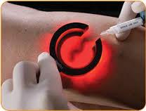
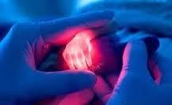
Vein visualisation
Vein illumination
The Device is envisaged for high quality transillumination to see even deeply embedded subcutaneous veins
Deoxygenated hemoglobin has higher light absorption coefficient then Oxygenated hemoglobin. Light is mainly absorbed by deoxy-Hb.
Visible light of wavelength 630 nm - 650 nm (Red) is used to locate vein in thick and dark skinned people whereas light of 540 nm (Orange) light source can be used for pediatric and fair skin patient.
The device helps medical professionals in identifying veins of any nature even in indoor dark room ambience

Slide 4
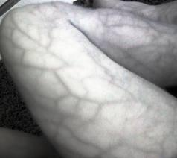

Vein visualisation
NIR (Near Infra Red) vein imaging
Unlike muscle and skin, blood is a stronger absorber of NIR radiation, which contrasts the subcutaneous vessels from skin and muscles in NIR imaging
Exposing the subject to infrared illumination of a specific wavelength, vein images can be captured and analyzed.
It is totally a non invasive technique
Real time projection of veins with accuracy on the skin surface
Deeper veins (lying even more than 15 mm in depth) can be viewed using this technique

Slide 5
Applications and Advantages
Vein Visualization is useful With a Variety of Patients like
Old age People, Dark-skinned patients, Obese patients whose veins may not be visible easily even after tourniqueting
Patients having many diagnostic or therapeutic intravenous procedures
Burn victims
Oncology patients under chemotherapy
Neonatals
Excellent and necessary tool for Emergency units, Ambulance, Nursing educationists and medical practitioners
Advantages:
Portability
No more guess work for vein infusion
Simple to use
More timely treatment
Builds satisfaction and confidence in patient
Accurate first attempt venous access, even for neonates

Slide 6
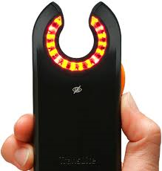
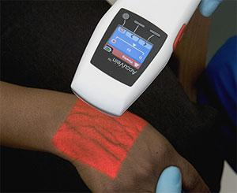
Existing Products
Vein Viewer - Using LED light of specific wavelength (manufactured in US and distributed worldwide)
Accuvein - Using IR rays with the projection module (manufactured in US and distributed worldwide)
In the western market already products for vein access exists. Indian medical industry use these equipments after importing them paying huge amount as tax. A simple version of the vein detector costs atleast $630 + tax and the projection type costs atleast $3500 + tax

Slide 7
Our Proposal
To reverse engineer these products, develop them at an affordable rate. We have been already successful in Indigenous development of LED vein illuminator for an amount less than $2
Similarly our team is optimistic enough to develop the projection type vein viewer at a cost lesser than $100
OUR AIM IS TO PULL BACK THE EXISTING INDIAN MEDICAL INDUSTRY FROM THE HANDS OF BUSINESS LOBBYISTS SO THAT COMMON PEOPLE HAVE ACCESS TO QUALITY HEALTH CARE FACILITY AT AN AFFORDABLE COST

Slide 8
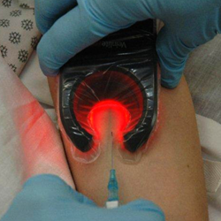
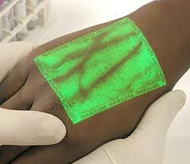
Our proposal contin..
Aim 1: To develop handheld Vein Detectors which aids health professionals to detect the complex venal system beneath the skin which can not otherwise be seen by our naked eye. The simple version consist of LEDs at a specified wavelength arranged in the periphery of a ‘C’ shaped device
Use: Usable in simple IV infusion to detect a proper vein lumen
Status: The prototype of the simple version has already been made and is under test for commercial acceptance and for the test of market strategy.
Aim 2: To develop the projection type vein contrast enhancers which would give even more exact image of the vasculature on the surface of the skin in real time
Use: Usable in vericose vein surgeries and complex other health care issues where exact location of vein needs to be traced
Status: Successfully tested the proof of concept but unable to develop a prototype due to lack of funds

Slide 9
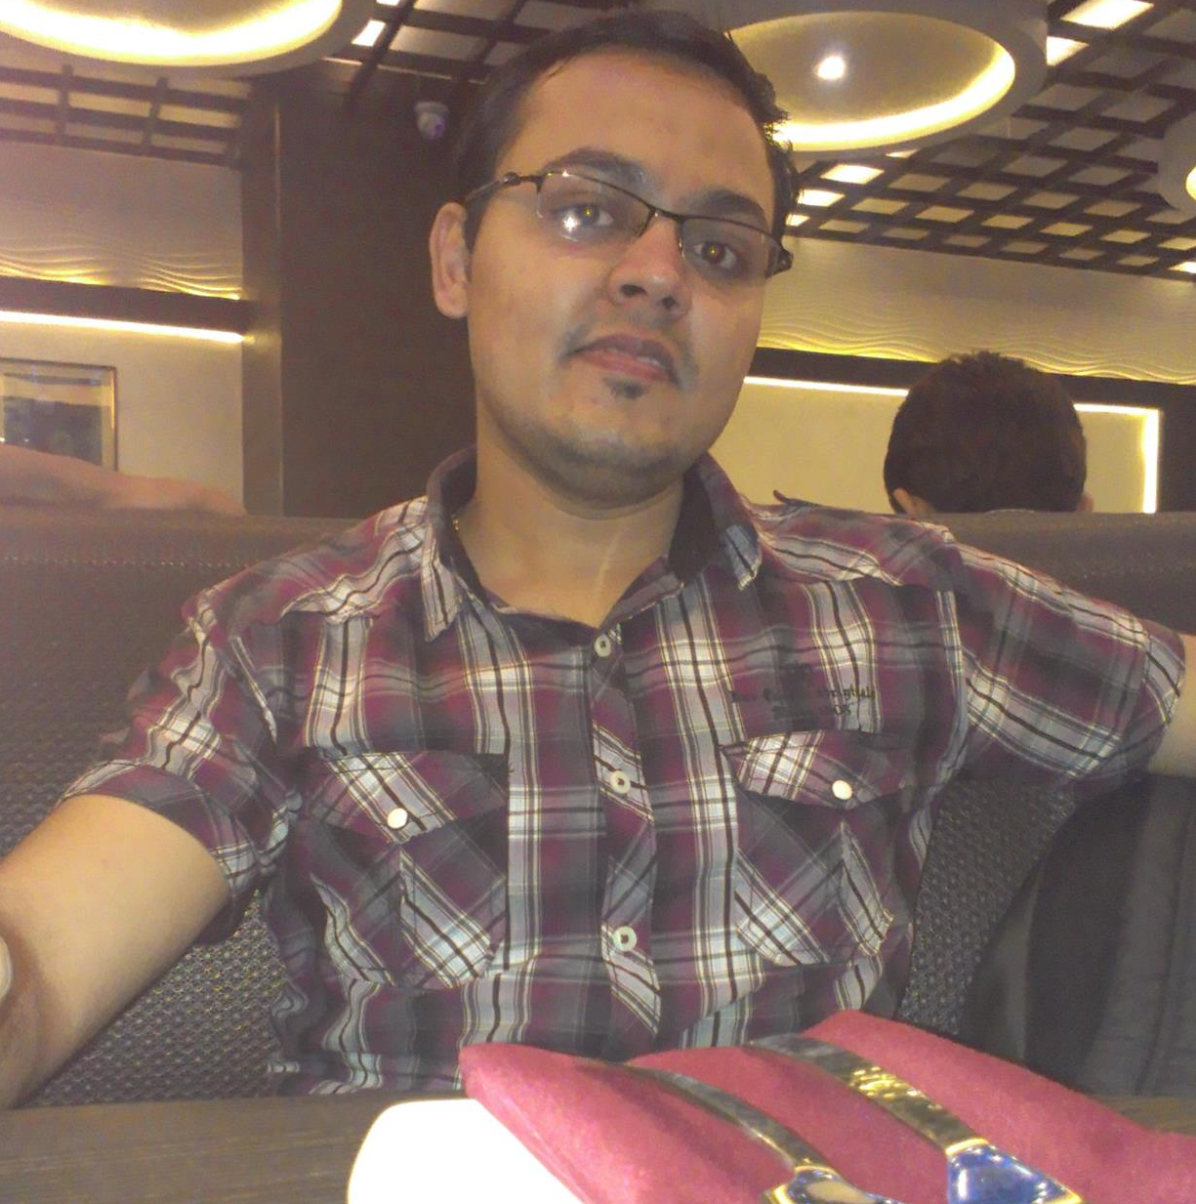

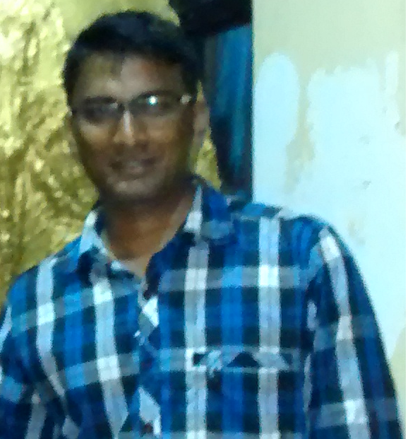
Team
Anantha Krishnan (IIT- K, 2013 passout)
He did his M.Tech In Photonics from IIT-K. He is interested in innovations and product development. He has work experience of approx. 1 year at EXL services.
Girish Nayak (IIT-B, 2011 Passout)
He did his M.tech from IIT-B in Electrical Eng. His passion for entrepreneurship bring him in to business. He is founding member of Startup https://rime.co . He has work experience of 2.5 Year @ IBM-ISL. .
Arun M P (Govt. College of Engg. Cherthala, 2010 passout)
He did his B.tech in electronics and communication engineering from Govt. COE, cherthala. He is a born techie, is heavily into robotics and a good team cheer.

